Slide 1





NAVIGATING FINANCIAL OBSTACLES:
LEVERAGING DATA IN VEGETABLE BUSINESS
Yash Singhal
21f3002767@ds.study.iitm.ac.in

Slide 2

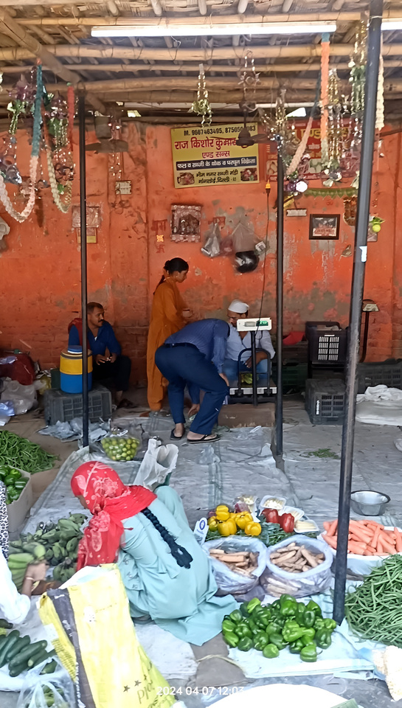
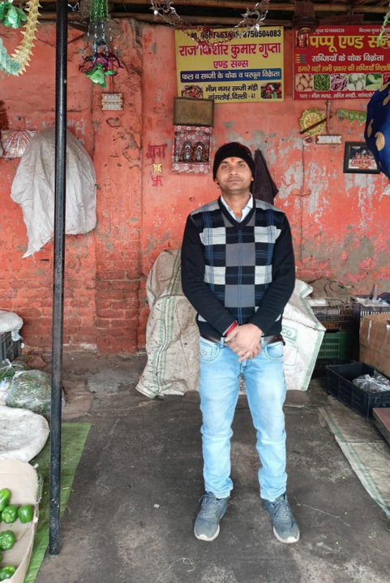
ABOUT THE BUSINESS
Raj Kishore Kumar Gupta and Sons is a well-established vegetable selling business with a 20-year legacy
Business functions in both B2B and B2C capacities, catering to small retail vegetable vendors and individual consumers
Owned by Mr. Raj Kishore Gupta, the business was originally a family venture, now solely managed by him

Slide 3


CHALLENGES
Absence of the proprietor's financial knowledge about the business such as Monthly Turnover
Uncertainty in determining appropriate profit margins
Lack of Structured
Credit Practices

Slide 4



DATA
OVERVIEW
Vegetable Data
Vegetable Name
Cost Price
Sell Price
Quantity
01.
To tackle these challenges following data was collected from the period 15 Jan, 2024 to 15 Feb, 2024
Credit Data
Customer Name
Transaction Date
Credit Amount
Repayment
Outstanding Balance
02.

Slide 5
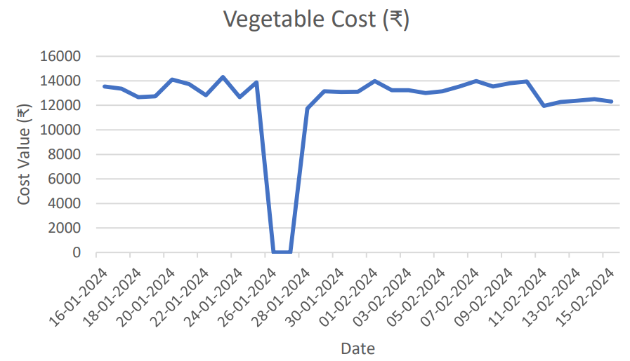
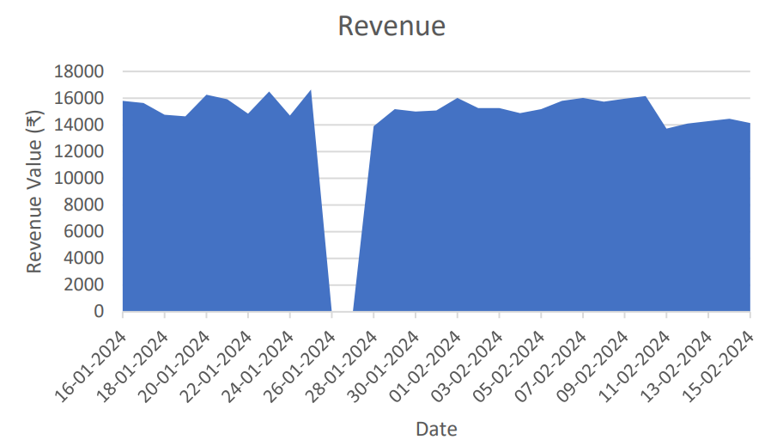
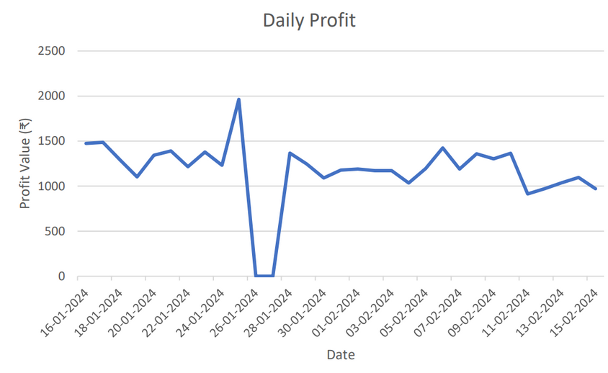
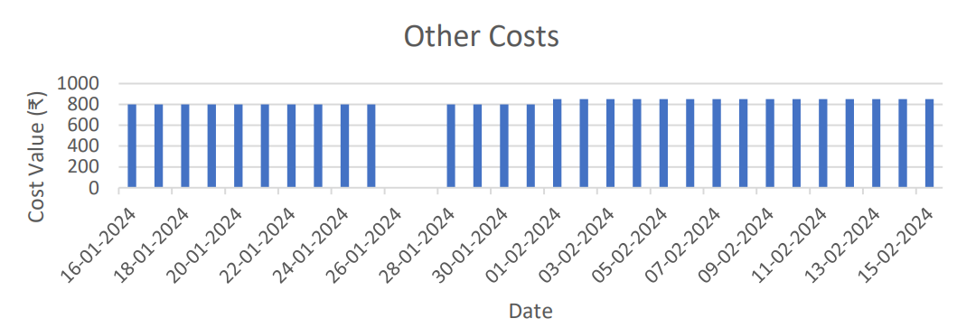
FINANCIAL OVERVIEW

Slide 6
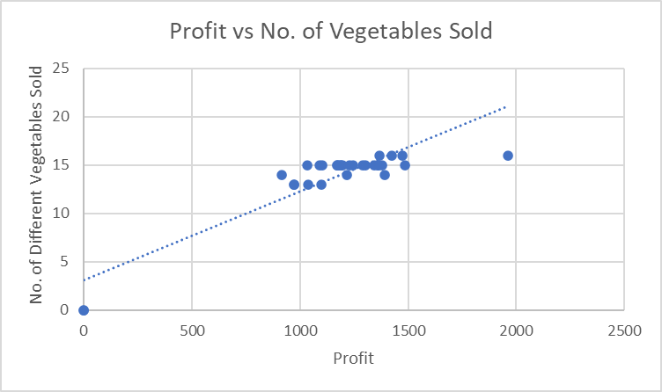
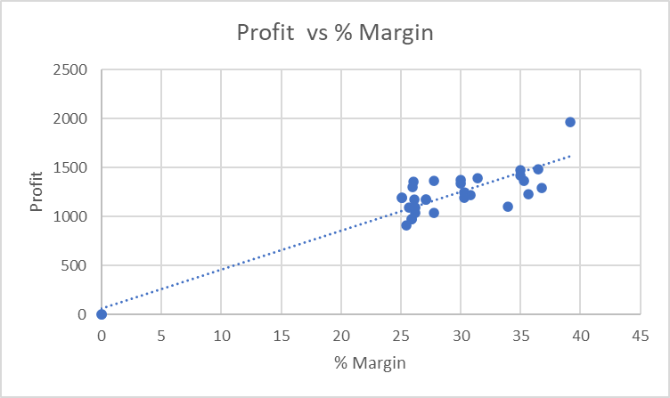
PROFIT ANALYSIS
Correlation: 0.6508
Correlation: 0.6893
By fitting a regression line equation, we have determined that the profit value at a 35%
margin is calculated to be ₹ 1419.31

Slide 7
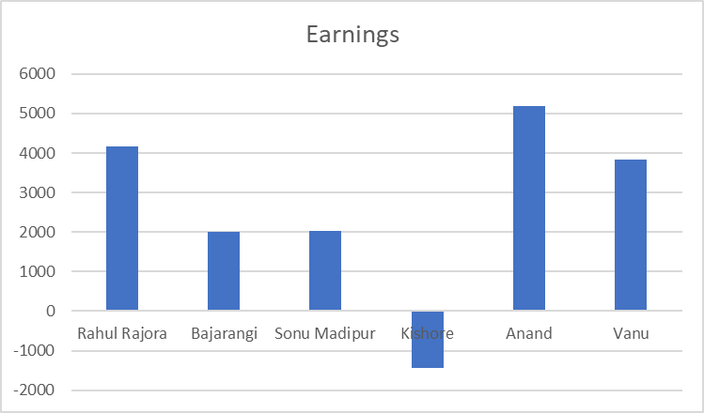
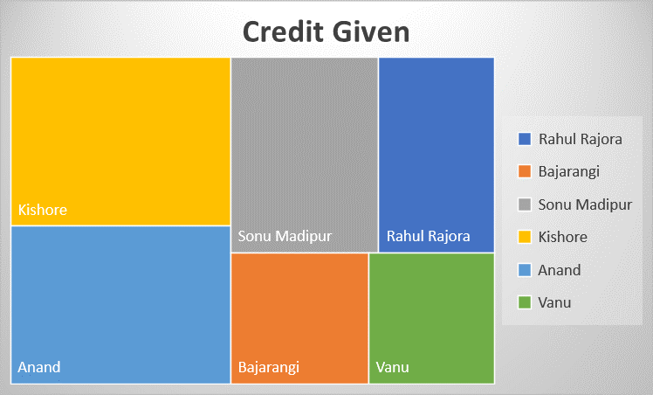
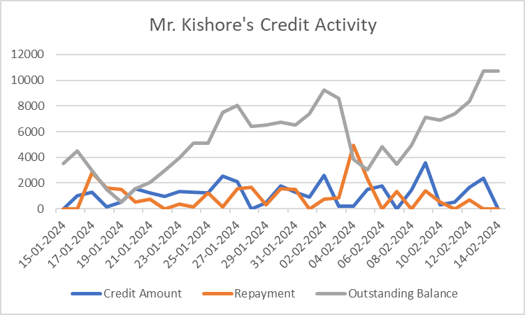
CREDIT ANALYSIS

Slide 8
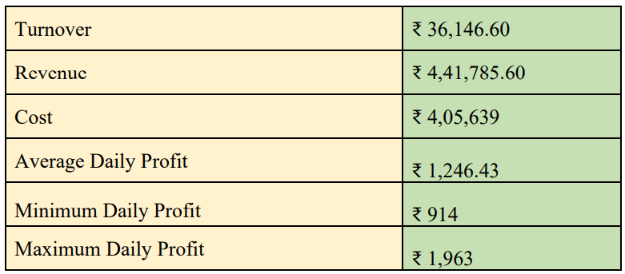
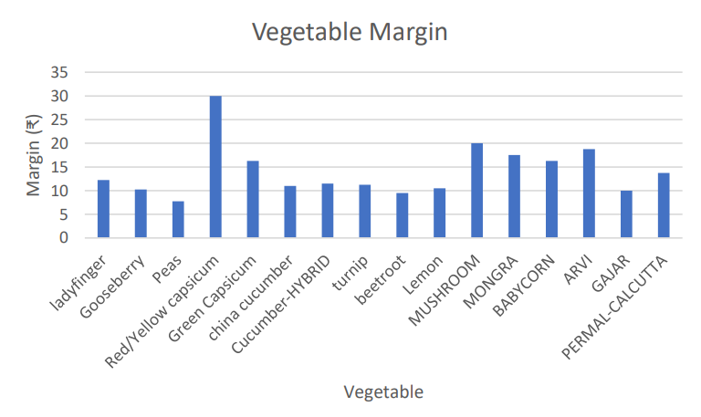
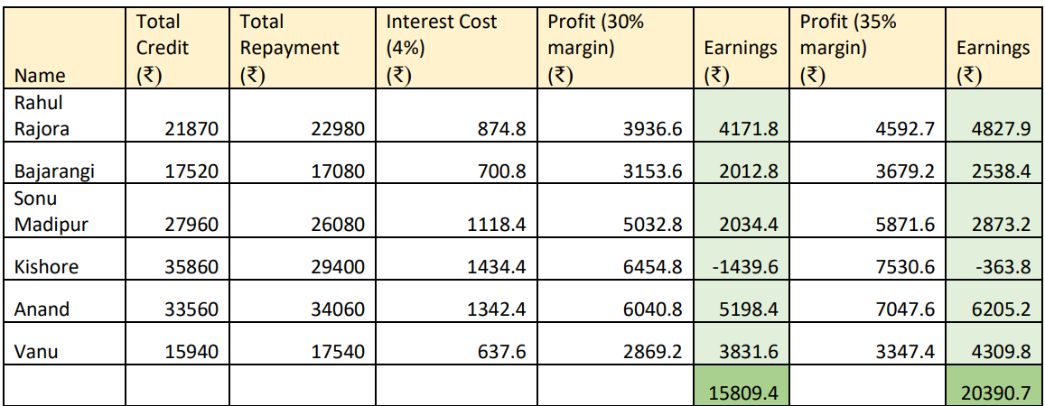
RESULTS AND RECOMMENDATIONS

Slide 9
RESULTS AND RECOMMENDATIONS
Expand Product Variety:
Diversify vegetable offerings to attract more customers and boost sales.
Improve customer satisfaction and loyalty with a wide selection of fresh, high-quality produce.
Differentiate from competitors by offering unique and specialty vegetables, e.g., red and yellow capsicum.
Implement Structured Credit Management:
Set caps on credit limits based on credit history and financial stability.
Regularly review credit utilization and monitor outstanding balances.
Use technology (e.g., accounting apps) for efficient credit management.
Enforce Strict Repayment Practices:
Establish clear repayment schedules with specified due dates.
Communicate repayment obligations transparently to customers.
Offer incentives for early repayment and penalties for late payments.
Closely monitor repayment performance and address issues promptly.

Slide 10
BDM PROJECT:
https://drive.google.com/drive/folders/1IXjYDdGPQdNLL9Y1CyIeazOZrTG5Cky8?usp=drive_link

